Slide 1
Under Guidance of
Dr. Sunil Simon
IIT, KANPUR
ALGORITHMIC GAME THEORY (CS656A)
Paper Review : Efficient reallocation under additive and responsive preferences.
Harsh Agarwal
21111030
18th November 2021

Slide 2
OUTLINE
Introduction
Notations And Definitions
Additive Utilities
Ordinal Preference
Conclusion
Reference

Slide 3
INTRODUCTION
Reallocation of resources in multi-agent system in a way that improves system’s social welfare or results in a better outcome is the most basic and important concern.
A well-known solution to the above-mentioned problem is finding a set of individually rational and Pareto Improvement assignments which converge to a Pareto Optimal solution.
Finding Pareto Optimal assignment from scratch is trivial.
So, we discuss ways to determine whether an initial assignment/ endowment is Pareto Optimal. If not, then we try to find a Pareto Optimal assignment which satisfies individual rationality.

Slide 4
INTRODUCTION
Testing Pareto Optimality of an assignment is computationally difficult and so is computing an individually rational and Pareto Optimal assignment is also computationally difficult.
For Cardinal Additive Utilities, a weak monotonicity assumption is made.
For Ordinal Preference, a strong monotonicity assumption is made.

Slide 5
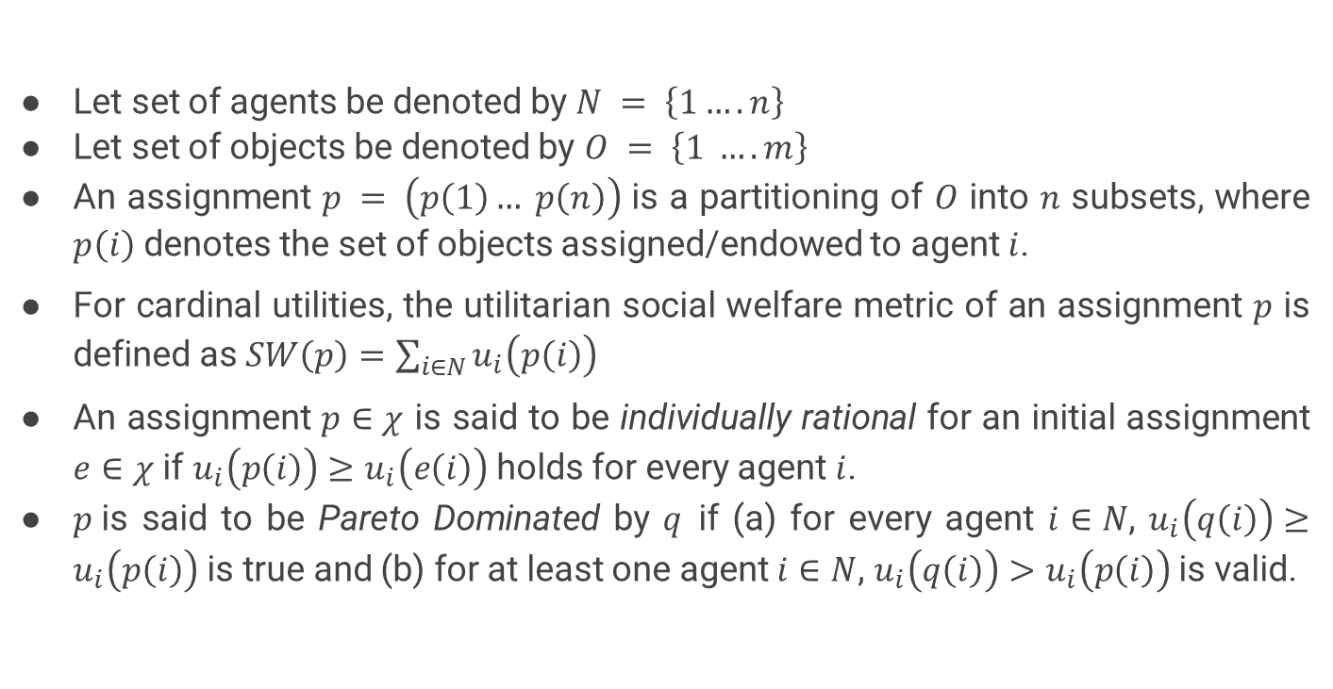
DEFINITIONS AND NOTATIONS
Let set of agents be denoted by $N = \left\{1…. n\right\}$
Let set of objects be denoted by $O = \left\{1 …. m\right\}$
An assignment $p = \left(p\left(1\right)… p\left(n\right)\right)$ is a partitioning of $O$ into $n$ subsets, where $p\left(i\right)$ denotes the set of objects assigned/endowed to agent $i$.
For cardinal utilities, the utilitarian social welfare metric of an assignment $p$ is defined as $SW\left(p\right)=\sum_{i∈N}{u_{i}\left(p\left(i\right)\right)}$
An assignment $p∈χ$ is said to be individually rational for an initial assignment $e∈χ$ if $u_{i}\left(p\left(i\right)\right)≥u_{i}\left(e\left(i\right)\right)$ holds for every agent $i$.
$p$is said to be Pareto Dominated by $q$if (a) for every agent $i∈N$, $u_{i}\left(q\left(i\right)\right)≥u_{i}\left(p\left(i\right)\right)$ is true and (b) for at least one agent $i∈N$, $u_{i}\left(q\left(i\right)\right)>u_{i}\left(p\left(i\right)\right)$is valid.

Slide 6
ADDITIVE UTILITIES
Hard Cases
Constant No of agents and small utilities
Lexicographic Utilities
Two Utility Values
Conservative Pareto Optimality.

Slide 7
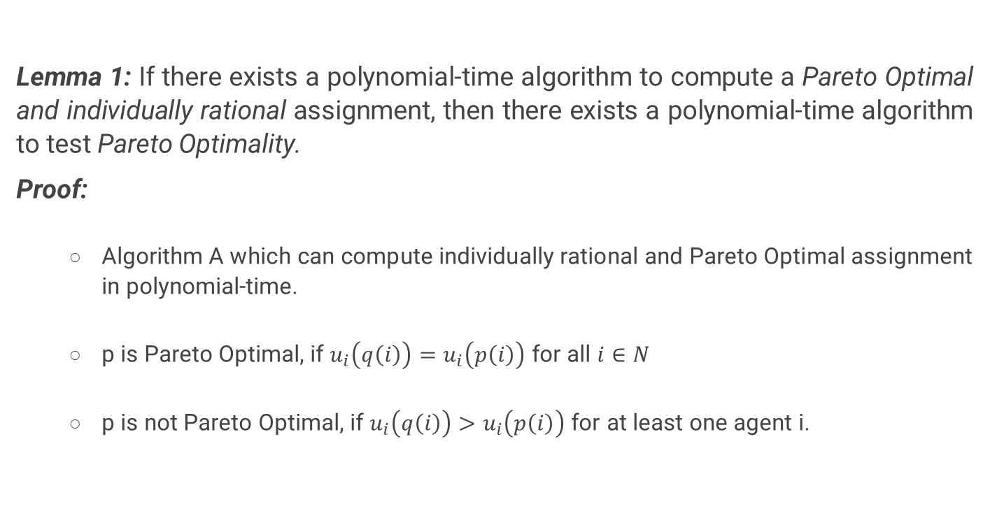
Hard Cases
Lemma 1: If there exists a polynomial-time algorithm to compute a Pareto Optimal and individually rational assignment, then there exists a polynomial-time algorithm to test Pareto Optimality.
Proof:
Algorithm A which can compute individually rational and Pareto Optimal assignment in polynomial-time.
p is Pareto Optimal, if $u_{i}\left(q\left(i\right)\right)=u_{i}\left(p\left(i\right)\right)$ for all $i∈N$
p is not Pareto Optimal, if $u_{i}\left(q\left(i\right)\right)>u_{i}\left(p\left(i\right)\right)$ for at least one agent i.

Slide 8
Hard Cases
Theorem 1: Under additive preferences, testing Pareto Optimality of a given assignment is weakly coNP-complete, even for n =2 even if the induced ordinal preferences over individual objects are the same.
Proof:
Testing Pareto Optimality is in coNP, as it is possible to determine whether an assignment is Pareto Dominated in polynomial time.
For completeness, we will reduce PARTITION problem into Testing Pareto Optimality problem
A Decision Problem $P$ is said to belong to coNP complexity class if and only if its complement ($\overline{P})$ is in the NP complexity class

Slide 9
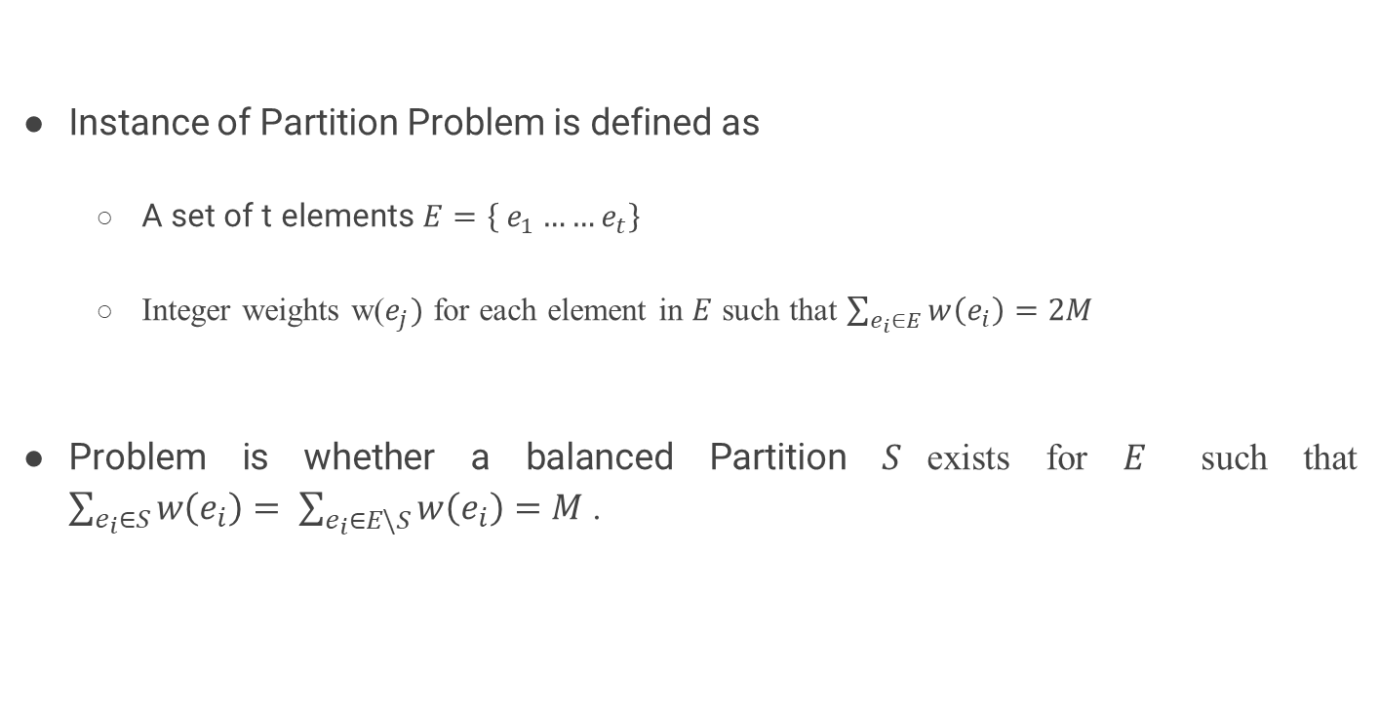
Hard Cases
Instance of Partition Problem is defined as
A set of t elements $E=\left\{ e_{1}……e_{t}\right\}$
Integer weights w($e_{j})$ for each element in $E$ such that $\sum_{e_{i}∈E}{w\left(e_{i}\right)=2M}$
Problem is whether a balanced Partition $S$exists for $E$ such that $\sum_{e_{i}∈S}{w\left(e_{i}\right)= \sum_{e_{i}∈E\backslash S}{w\left(e_{i}\right)=M} }$.

Slide 10
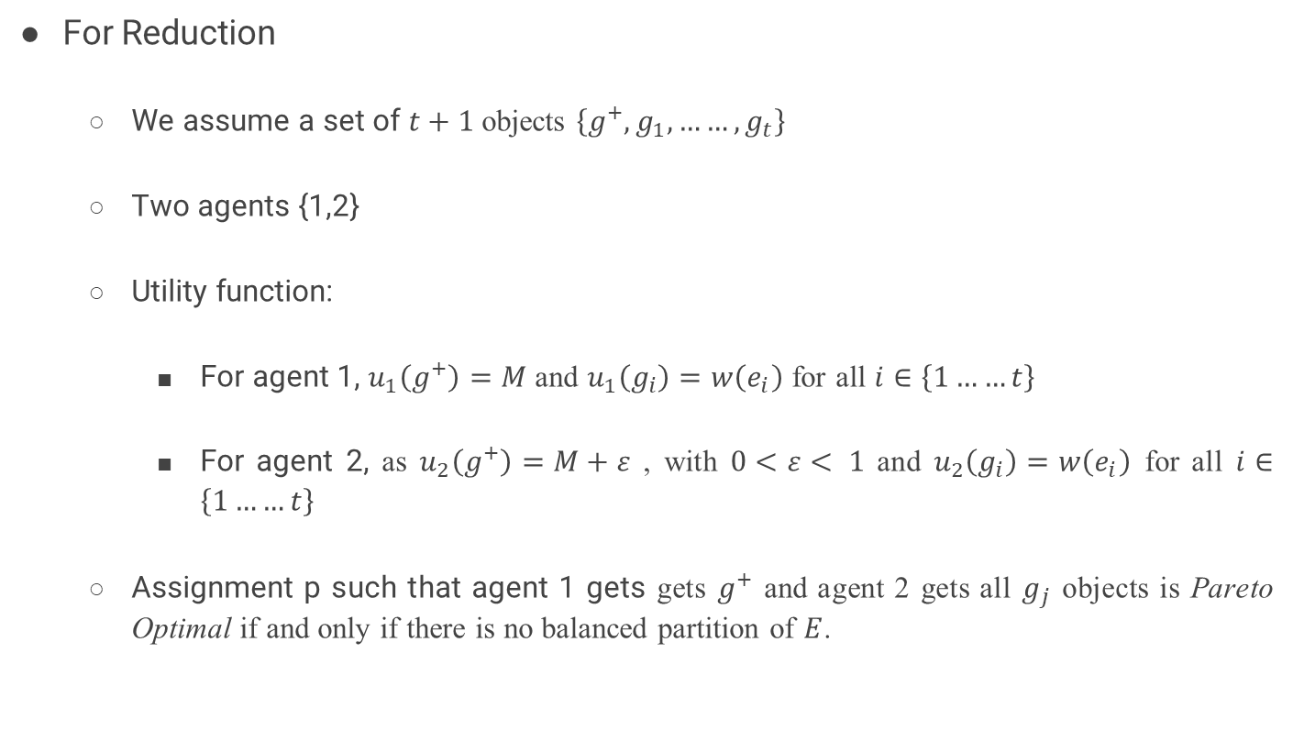
Hard Cases
For Reduction
We assume a set of $t+1$objects $\left\{g^{+}, g_{1}, ……, g_{t}\right\}$
Two agents {1,2}
Utility function:
For agent 1, $u_{1}\left(g^{+}\right)=M$ and $u_{1}\left(g_{i}\right)=w\left(e_{i}\right)$ for all $i∈\left\{1……t\right\}$
For agent 2, as $u_{2}\left(g^{+}\right)=M+ε$ , with $0<ε< 1$ and $u_{2}\left(g_{i}\right)=w\left(e_{i}\right)$ for all $i∈\left\{1……t\right\}$
Assignment p such that agent 1 gets gets $g^{+}$ and agent 2 gets all $g_{j}$ objects is Pareto Optimal if and only if there is no balanced partition of $E$.

Slide 11
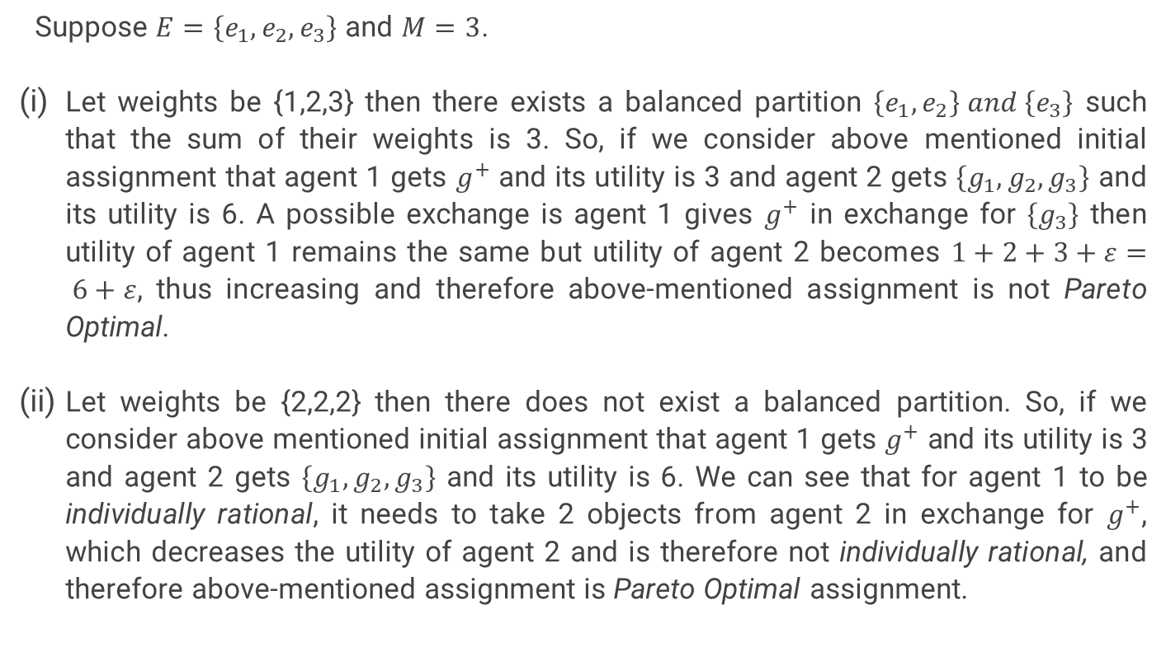
Hard Cases Example
Suppose $E=\left\{e_{1},e_{2},e_{3}\right\}$ and $M=3$.
Let weights be {1,2,3} then there exists a balanced partition $\left\{e_{1},e_{2}\right\} and \left\{e_{3}\right\}$ such that the sum of their weights is 3. So, if we consider above mentioned initial assignment that agent 1 gets $g^{+}$ and its utility is 3 and agent 2 gets $\left\{g_{1},g_{2},g_{3}\right\}$ and its utility is 6. A possible exchange is agent 1 gives $g^{+}$ in exchange for $\left\{g_{3}\right\}$ then utility of agent 1 remains the same but utility of agent 2 becomes $1+2+3+ε= 6+ε$, thus increasing and therefore above-mentioned assignment is not Pareto Optimal.
Let weights be {2,2,2} then there does not exist a balanced partition. So, if we consider above mentioned initial assignment that agent 1 gets $g^{+}$ and its utility is 3 and agent 2 gets $\left\{g_{1},g_{2},g_{3}\right\}$ and its utility is 6. We can see that for agent 1 to be individually rational, it needs to take 2 objects from agent 2 in exchange for $g^{+}$, which decreases the utility of agent 2 and is therefore not individually rational, and therefore above-mentioned assignment is Pareto Optimal assignment.

Slide 12
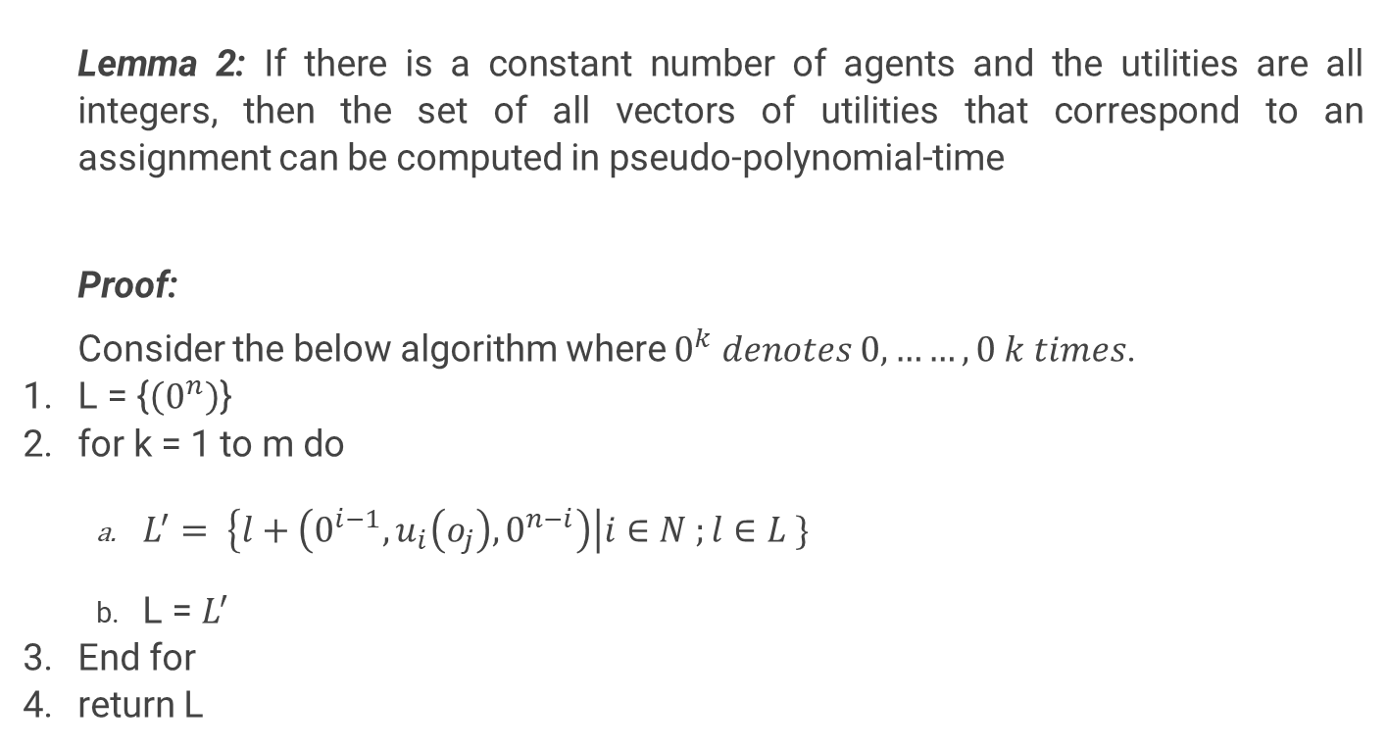
Constant number of agents and small utilities
Lemma 2: If there is a constant number of agents and the utilities are all integers, then the set of all vectors of utilities that correspond to an assignment can be computed in pseudo-polynomial-time
Proof:
Consider the below algorithm where $0^{k} denotes 0,……,0 k times$.
L = {$\left(0^{n}\right)$}
for k = 1 to m do
$L^{′}= \left\{l+\left(0^{i−1},u_{i}\left(o_{j}\right),0^{n−i}\right)\right|i∈N ;l∈L \}$
L = $L^{′}$
End for
return L

Slide 13
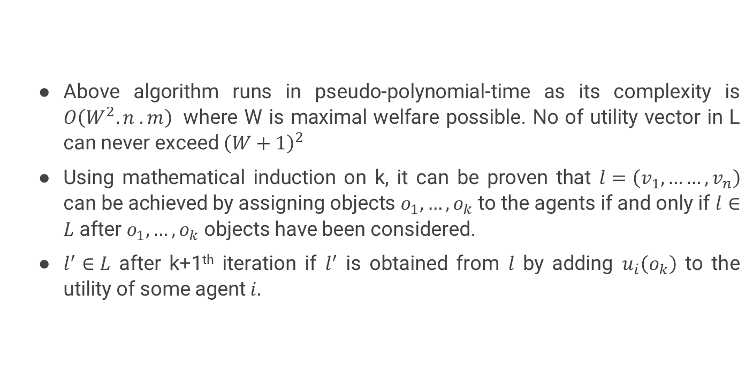
Constant number of agents and small utilities
Above algorithm runs in pseudo-polynomial-time as its complexity is $O\left(W^{2}. n .m\right)$ where W is maximal welfare possible. No of utility vector in L can never exceed ${\left(W+1\right)}^{2}$
Using mathematical induction on k, it can be proven that $l=\left(v_{1},……,v_{n}\right)$ can be achieved by assigning objects $o_{1},…,o_{k}$ to the agents if and only if $l∈L$ after $o_{1},…,o_{k}$ objects have been considered.
$l^{′}∈L$ after k+1th iteration if $l^{′}$ is obtained from $l$ by adding $u_{i}\left(o_{k}\right)$ to the utility of some agent $i.$

Slide 14
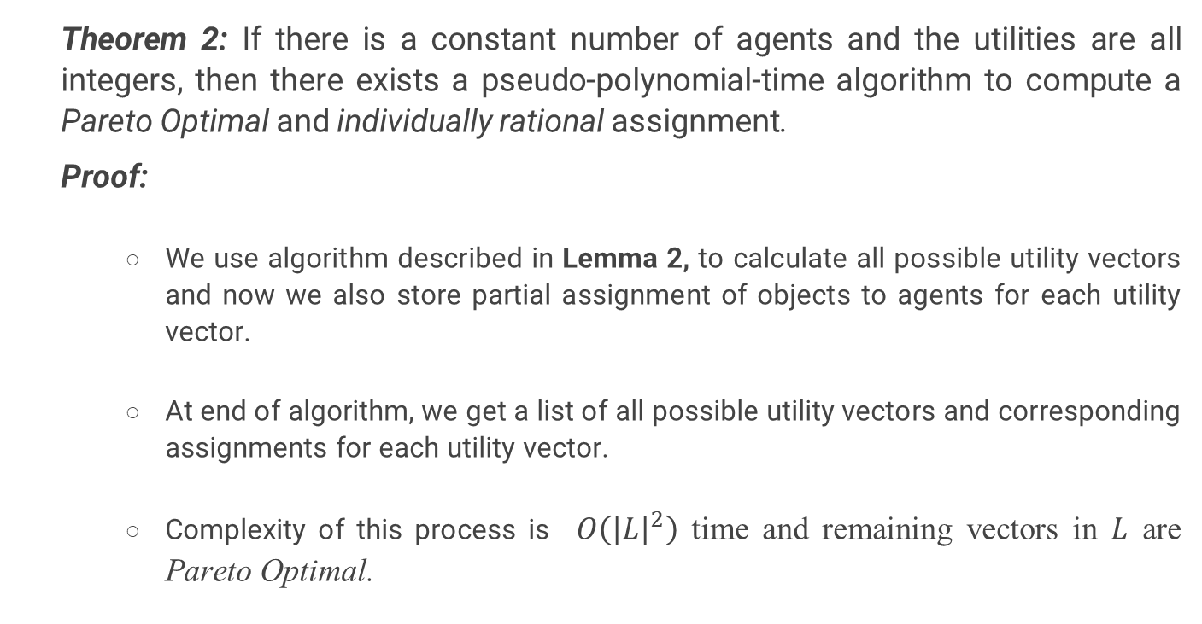
Constant number of agents and small utilities
Theorem 2: If there is a constant number of agents and the utilities are all integers, then there exists a pseudo-polynomial-time algorithm to compute a Pareto Optimal and individually rational assignment.
Proof:
We use algorithm described in Lemma 2, to calculate all possible utility vectors and now we also store partial assignment of objects to agents for each utility vector.
At end of algorithm, we get a list of all possible utility vectors and corresponding assignments for each utility vector.
Complexity of this process is $O\left({\left|L\right|}^{2}\right)$ time and remaining vectors in $L$ are Pareto Optimal.

Slide 15
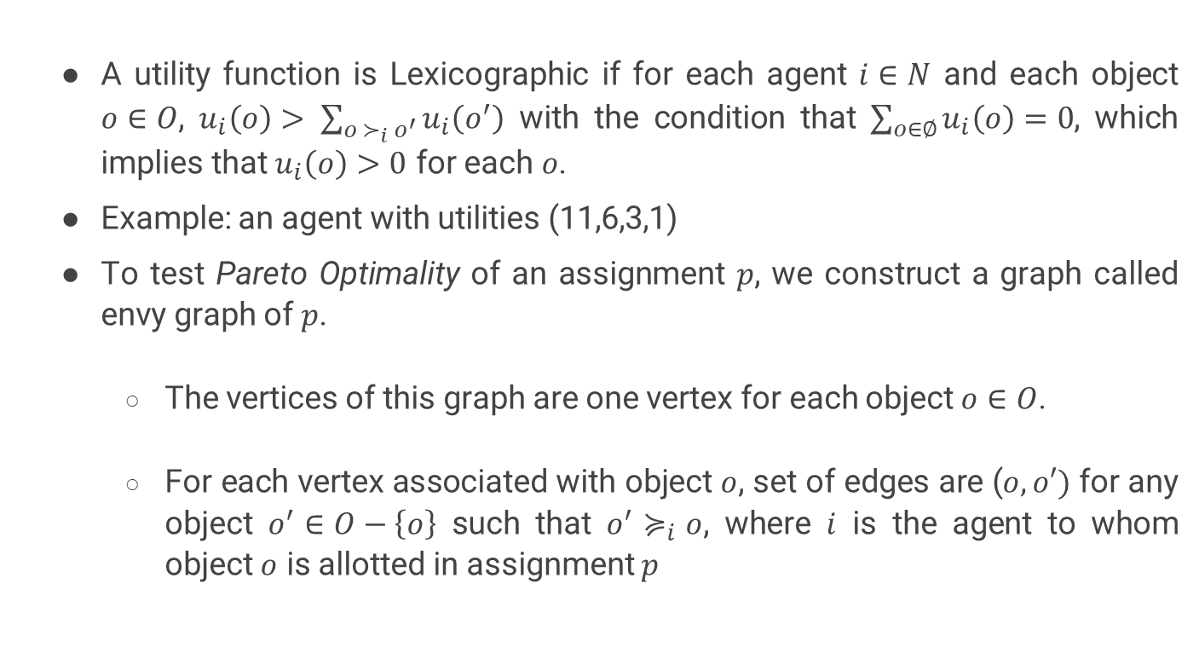
Lexicographic Utilities
A utility function is Lexicographic if for each agent $i∈N$ and each object $o∈O$, $u_{i}\left(o\right)> \sum_{o ≻_{i} o^{′}}{u_{i}\left(o^{′}\right)}$ with the condition that $\sum_{o∈∅}{u_{i}\left(o\right)}=0$, which implies that $u_{i}\left(o\right)>0$ for each$o$.
Example: an agent with utilities (11,6,3,1)
To test Pareto Optimality of an assignment $p$, we construct a graph called envy graph of $p$.
The vertices of this graph are one vertex for each object $o∈O$.
For each vertex associated with object $o$, set of edges are ($o,o′)$ for any object $o^{′}∈O−\left\{o\right\}$ such that $o^{′}≽_{i}o$, where $i$ is the agent to whom object $o$ is allotted in assignment $p$

Slide 16
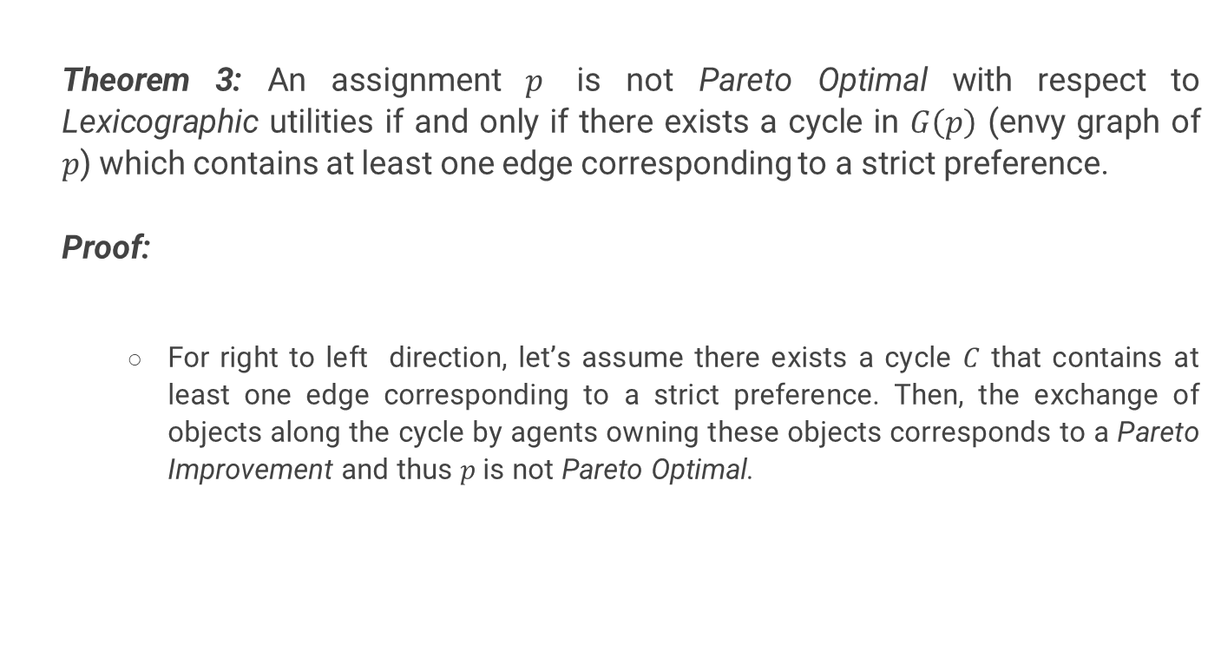
Lexicographic Utilities
Theorem 3: An assignment $p$ is not Pareto Optimal with respect to Lexicographic utilities if and only if there exists a cycle in $G\left(p\right)$ (envy graph of $p$) which contains at least one edge corresponding to a strict preference.
Proof:
For right to left direction, let’s assume there exists a cycle $C$ that contains at least one edge corresponding to a strict preference. Then, the exchange of objects along the cycle by agents owning these objects corresponds to a Pareto Improvement and thus $p$is not Pareto Optimal.

Slide 17
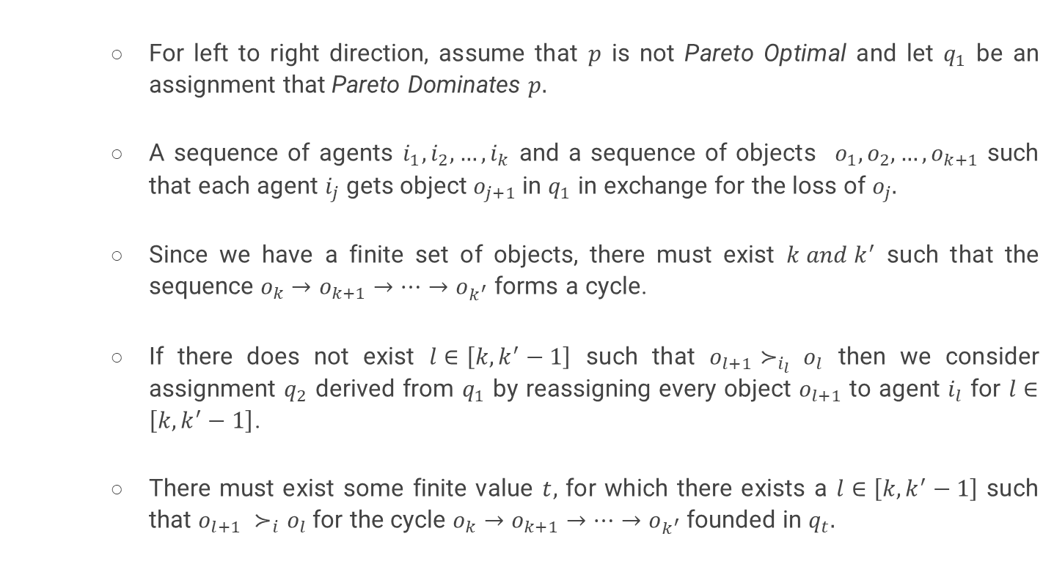
Lexicographic Utilities
For left to right direction, assume that $p$ is not Pareto Optimal and let $q_{1}$ be an assignment that Pareto Dominates $p.$
A sequence of agents $i_{1},i_{2},…,i_{k}$ and a sequence of objects $o_{1},o_{2},…,o_{k+1}$ such that each agent $i_{j}$ gets object $o_{j+1}$ in $q_{1}$ in exchange for the loss of $o_{j}.$
Since we have a finite set of objects, there must exist $k and k^{′}$ such that the sequence $o_{k}→o_{k+1}→…→o_{k^{′}}$ forms a cycle.
If there does not exist $l∈\left[k,k^{′}−1\right]$ such that $o_{l+1}≻_{i_{l}} o_{l}$ then we consider assignment $q_{2}$ derived from $q_{1}$ by reassigning every object $o_{l+1}$ to agent $i_{l}$ for $l∈\left[k,k^{′}−1\right]$.
There must exist some finite value $t,$ for which there exists a $l∈\left[k,k^{′}−1\right]$ such that $o_{l+1} ≻_{i}o_{l}$ for the cycle $o_{k}→o_{k+1}→…→o_{k^{′}}$ founded in $q_{t}.$

Slide 18
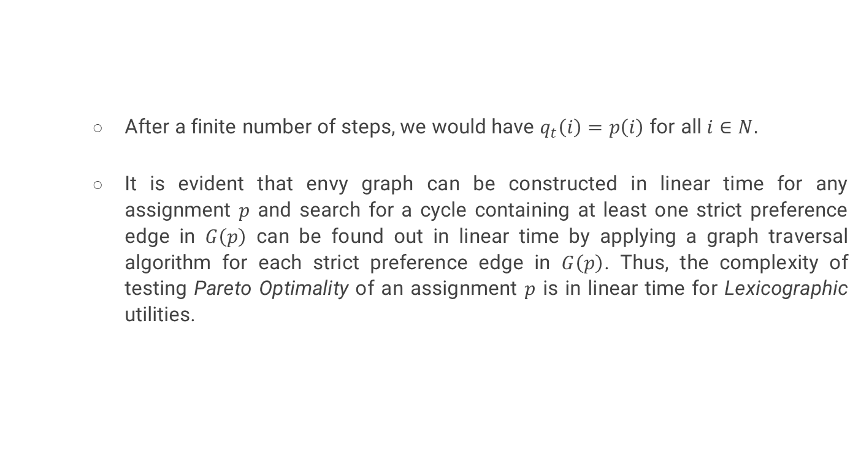
Lexicographic Utilities
After a finite number of steps, we would have $q_{t}\left(i\right)=p\left(i\right)$ for all $i∈N.$
It is evident that envy graph can be constructed in linear time for any assignment $p$ and search for a cycle containing at least one strict preference edge in $G\left(p\right)$ can be found out in linear time by applying a graph traversal algorithm for each strict preference edge in $G\left(p\right)$. Thus, the complexity of testing Pareto Optimality of an assignment $p$ is in linear time for Lexicographic utilities.

Slide 19
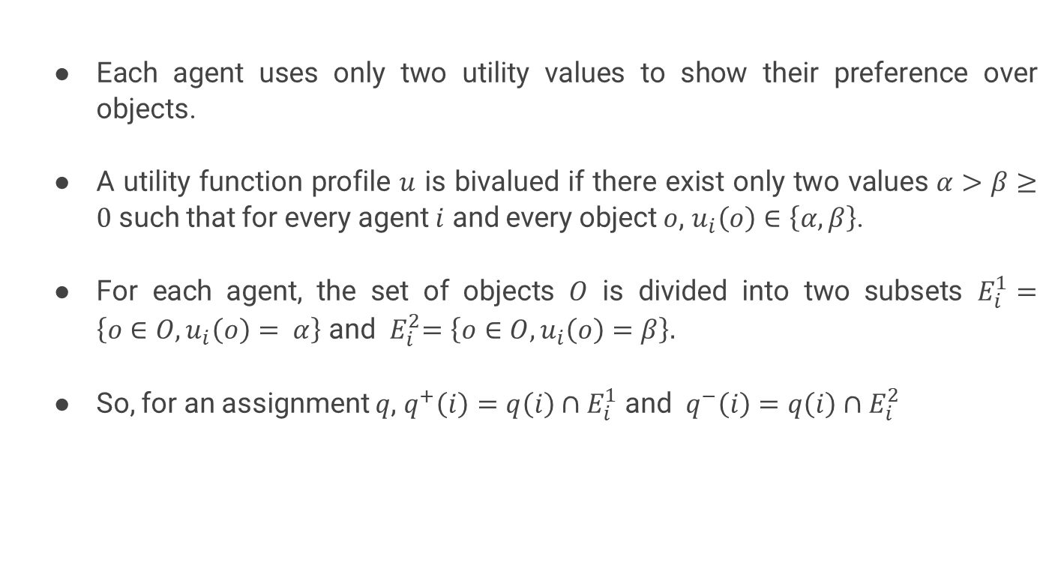
Two Utility Values
Each agent uses only two utility values to show their preference over objects.
A utility function profile $u$ is bivalued if there exist only two values $α>β≥0$ such that for every agent $i$ and every object $o$, $u_{i}\left(o\right)∈\left\{α,β\right\}$.
For each agent, the set of objects $O$ is divided into two subsets $E_{i}^{1}=\left\{o∈O, u_{i}\left(o\right)= α\right\}$ and ${ E}_{i}^{2}=\left\{o∈O, u_{i}\left(o\right)=β\right\}.$
So, for an assignment $q$, $q^{+}\left(i\right)=q\left(i\right)∩E_{i}^{1}$ and $q^{−}\left(i\right)=q\left(i\right)∩E_{i}^{2}$

Slide 20
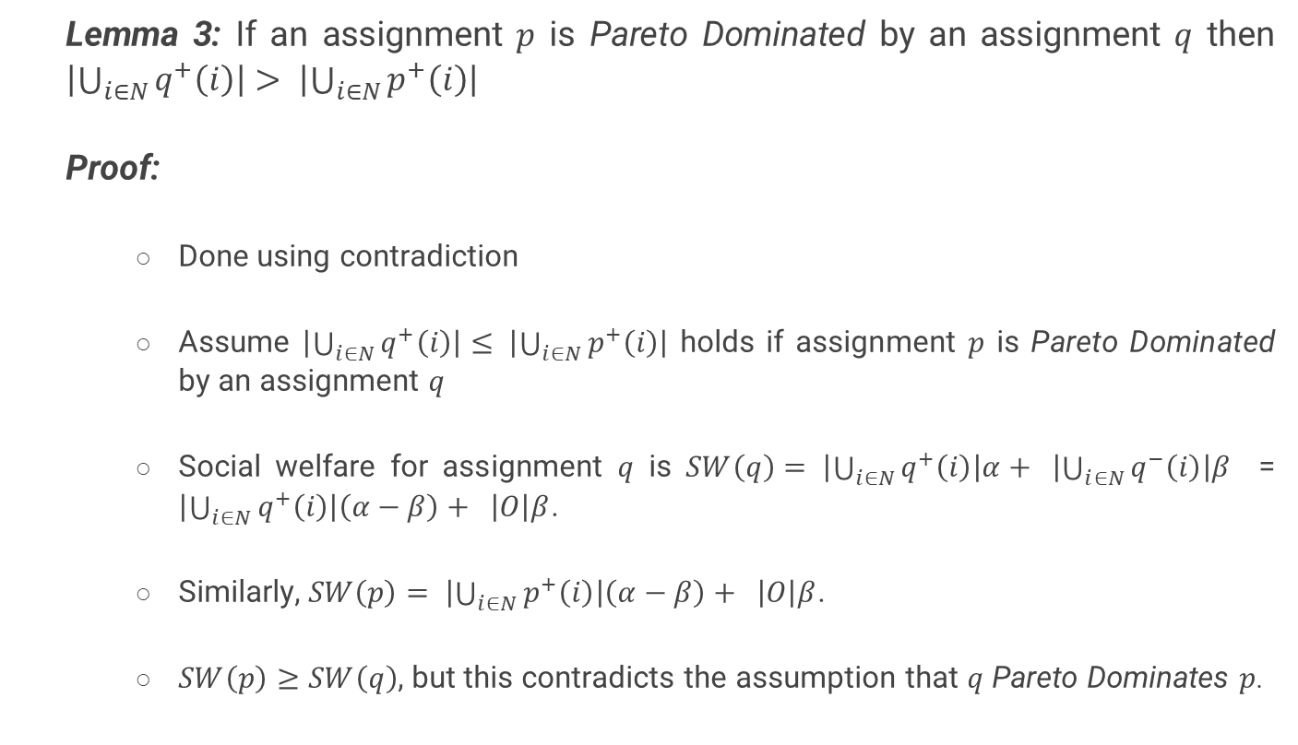
Two Utility Values
Lemma 3: If an assignment $p$ is Pareto Dominated by an assignment $q$ then $\left|\bigcup_{i∈N}{q^{+}\left(i\right)}\right|> \left|\bigcup_{i∈N}{p^{+}\left(i\right)}\right|$
Proof:
Done using contradiction
Assume $\left|\bigcup_{i∈N}{q^{+}\left(i\right)}\right|≤ \left|\bigcup_{i∈N}{p^{+}\left(i\right)}\right|$ holds if assignment $p$ is Pareto Dominated by an assignment $q$
Social welfare for assignment $q$ is $SW\left(q\right)= \left|\bigcup_{i∈N}{q^{+}\left(i\right)}\right|α+ \left|\bigcup_{i∈N}{q^{−}\left(i\right)}\right|β$ = $\left|\bigcup_{i∈N}{q^{+}\left(i\right)}\right|\left(α−β\right)+ \left|O\right|β$.
Similarly, $SW\left(p\right)= \left|\bigcup_{i∈N}{p^{+}\left(i\right)}\right|\left(α−β\right)+ \left|O\right|β$.
$SW\left(p\right)≥SW\left(q\right)$, but this contradicts the assumption that $q$ Pareto Dominates $p$.

Slide 21
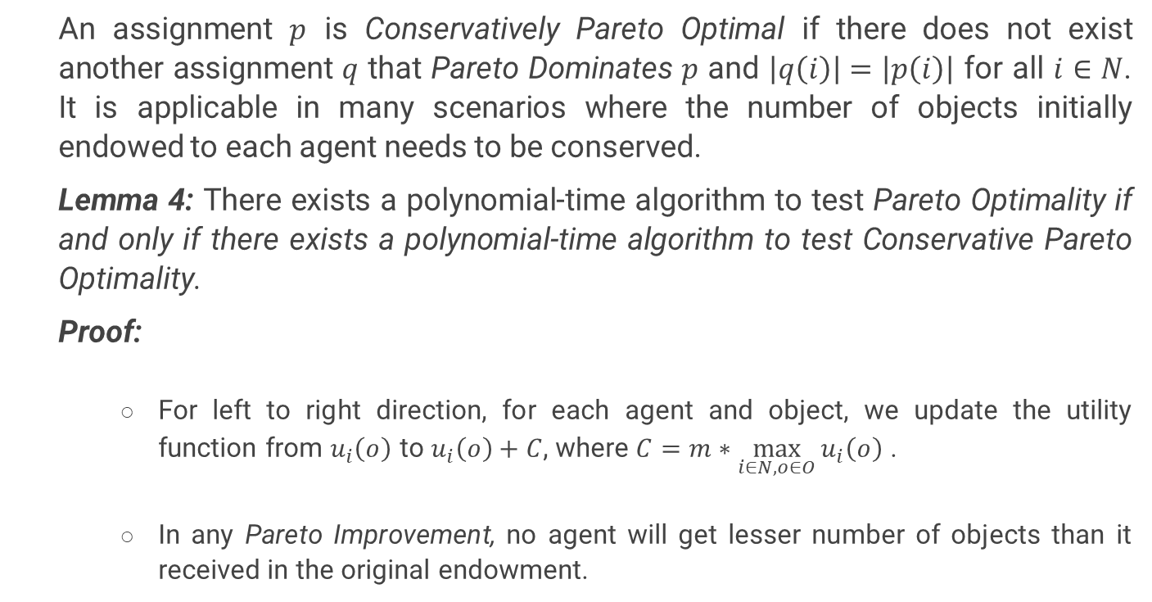
Conservative Pareto Optimality
An assignment $p$ is Conservatively Pareto Optimal if there does not exist another assignment $q$ that Pareto Dominates $p$ and $\left|q\left(i\right)\right|=\left|p\left(i\right)\right|$ for all $i∈N$. It is applicable in many scenarios where the number of objects initially endowed to each agent needs to be conserved.
Lemma 4: There exists a polynomial-time algorithm to test Pareto Optimality if and only if there exists a polynomial-time algorithm to test Conservative Pareto Optimality.
Proof:
For left to right direction, for each agent and object, we update the utility function from $u_{i}\left(o\right)$ to $u_{i}\left(o\right)+C$, where $C=m∗\max_{i∈N, o∈O}{u_{i}\left(o\right)}$ .
In any Pareto Improvement, no agent will get lesser number of objects than it received in the original endowment.

Slide 22
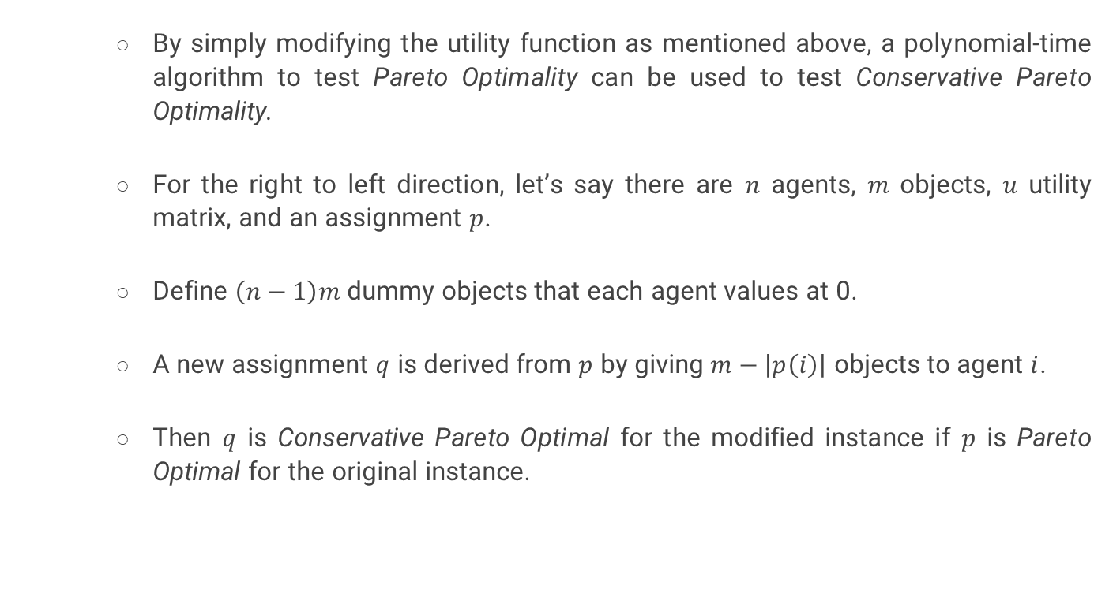
Conservative Pareto Optimality
By simply modifying the utility function as mentioned above, a polynomial-time algorithm to test Pareto Optimality can be used to test Conservative Pareto Optimality.
For the right to left direction, let’s say there are $n$ agents, $m$ objects, $u$ utility matrix, and an assignment $p$.
Define $\left(n−1\right)m$ dummy objects that each agent values at 0.
A new assignment $q$ is derived from $p$ by giving $m−\left|p\left(i\right)\right|$ objects to agent $i$.
Then $q$ is Conservative Pareto Optimal for the modified instance if $p$ is Pareto Optimal for the original instance.

Slide 23
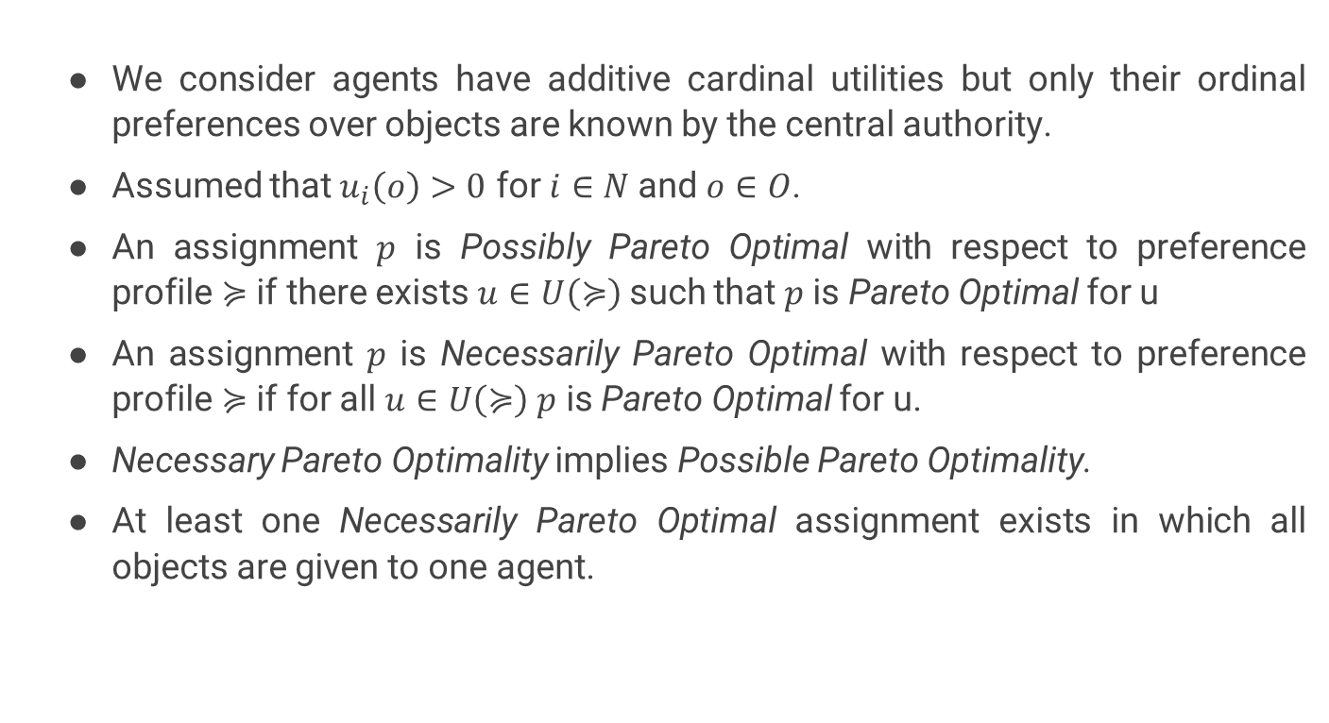
Ordinal Preference
We consider agents have additive cardinal utilities but only their ordinal preferences over objects are known by the central authority.
Assumed that $u_{i}\left(o\right)>0$ for $i∈N$and $o∈O$.
An assignment $p$ is Possibly Pareto Optimal with respect to preference profile $≽$ if there exists $u∈U\left(≽\right)$ such that $p$ is Pareto Optimal for u
An assignment $p$ is Necessarily Pareto Optimal with respect to preference profile $≽$ if for all $u∈U\left(≽\right)$ $p$ is Pareto Optimal for u.
Necessary Pareto Optimality implies Possible Pareto Optimality.
At least one Necessarily Pareto Optimal assignment exists in which all objects are given to one agent.

Slide 24
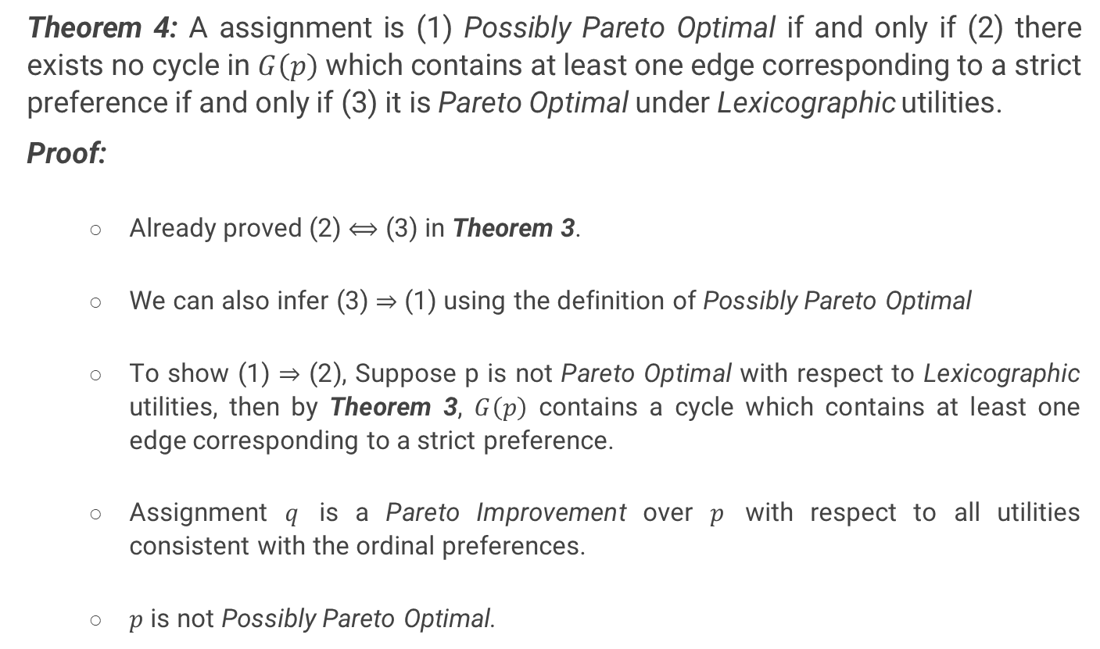
Ordinal Preference
Theorem 4: A assignment is (1) Possibly Pareto Optimal if and only if (2) there exists no cycle in $G\left(p\right)$ which contains at least one edge corresponding to a strict preference if and only if (3) it is Pareto Optimal under Lexicographic utilities.
Proof:
Already proved (2) $⟺$ (3) in Theorem 3.
We can also infer (3) $⇒$ (1) using the definition of Possibly Pareto Optimal
To show (1) $⇒$ (2), Suppose p is not Pareto Optimal with respect to Lexicographic utilities, then by Theorem 3, $G\left(p\right)$ contains a cycle which contains at least one edge corresponding to a strict preference.
Assignment $q$ is a Pareto Improvement over $p$ with respect to all utilities consistent with the ordinal preferences.
$p$ is not Possibly Pareto Optimal.

Slide 25
CONCLUSION
From a computational point of view, Pareto Optimality in resource reallocation under additive utilities and ordinal preferences was studied and the paper came up with various characterization theorems and polynomial-time algorithms to solve problems of testing Pareto Optimality under various conditions.

Slide 26
REFERENCE
Haris Aziz, Péter Biró, Jérôme Lang, Julien Lesca, Jérôme Monnot, Efficient reallocation under additive and responsive preferences.

Slide 27
THANK YOU

